Slide 1

مرحباٌ بكم ...
في دورة كفاءة اللغة الإنكليزية للطلبة المتقدمين للدراسات العليا والتي يقيمها مركز الحاسبة في جامعة ديالى عنوان محاضرة اليوم
How to writ
a composition in simple way

Slide 2
How to write a paragraph…
Presented by
Inst. Hazim Mohamed Ali
College of Basic Education,
University of Diyala
2019 - 2020

Slide 3
Welcome everybody
4
2
1
5
3

Slide 4

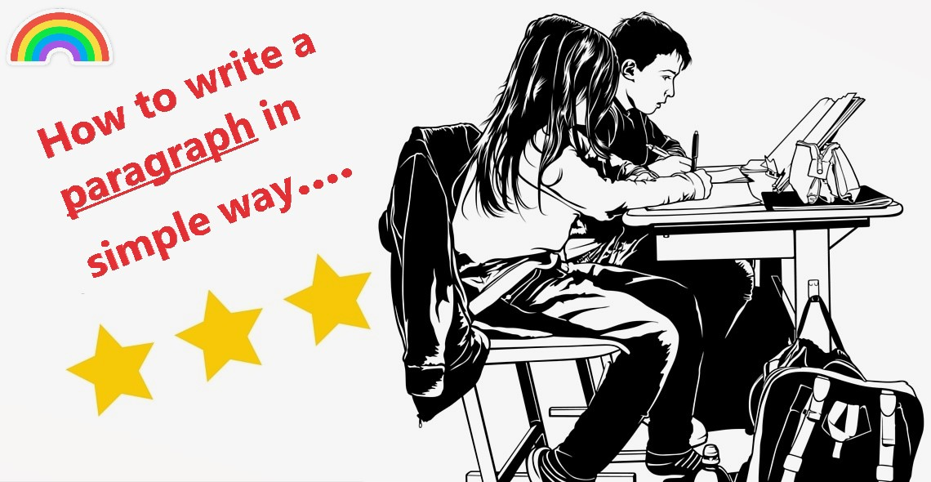

Slide 5

I will take you in five sections of my lecture….
1
2
3
4
5

Slide 6

Our lecture is talking about
Parts of speech
Our lecture is talking about
Sentence and type of sentences
Paragraph and diagram of composition
Rules and punctuation marks
Sample of finial test

Slide 7
9 - Parts of Speech
Articles
Interjections
Prepositions
Pronouns
Conjunctions
Verb
Adverb
Noun
Adjective

Slide 8

1 - Noun
There are several different types of noun, as follows:
Common noun
Proper noun
Abstract noun
Collective nouns
Common nouns refer to people, places and things in general like chair or dog. Any noun that is not a name is a common
Names of people, places
Your name is a proper noun. London is a proper noun.
Abstract nouns are ideas,
concepts and feelings.
happiness, courage, danger, truth
A collective noun denotes a group of individuals.
class (group of students)
family , Iraqi Army

Slide 9
2 - Verb
Past participle
5
gone, cut, worked
4
Present participle
She has gone to
school by bus this morning,
going, cutting, working
She is going to school buy bus now.
Past verb
3
went, cut, worked
2
She went to school by bus yesterday.
3 person singular
goes, cuts, works
She goes to school everyday by bus,
Base of verb
1
go, cut. work
I go to school everyday by bus.

Slide 10
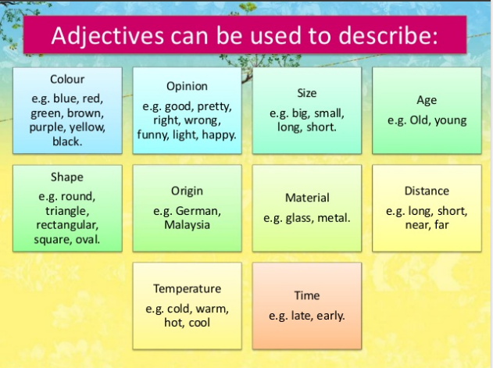
3 - Adjective
Adjectives are words that describe nouns. Adjectives answer such questions as:
What kind? Which one? How many?

Slide 11
4 - Adverb
An adverb is a word that is used to change, modify or qualify several types of words including an adjective, a verb, a clause.
Adverbs of manner
Adverbs of place
Adverbs of
time
Conjunctive Adverbs
Adverbs that express the manner, approach, process of the action in the sentence .
Please, handle the camera carefully.
Adverbs of time/frequency indicate time or frequency of the action in the sentence.
He always gets a good result.
connects phrases or independent clauses. It provides transitions between ideas and shows relationships.
We are still confused, however, if umpires will come.
direction that indicate place/direction of the action in the sentence.
He is staying at my home.
1
2
3
4

Slide 12
5 - Pronouns
I
She
he
Thy
Possessive
Pronouns
That book is mine.
we
Object
Pronouns
I will give her some money.
Possessive
Adjective
This is my book.
You
Reflexive
Pronouns
I can see myself in mirror.
Subject
Pronouns
She helps her mother every day.
it

Slide 13
Prepositions of Time
show the relationship of time between the nouns to the other parts of a sentence.
on, at, in, from, to, for
6 - Prepositions
Prepositions of Place
show the relationship of place between the nouns to the other parts of a sentence.
up, down, over, between
Prepositions of Agents
indicate a casual relationship between nouns and other parts of the sentence.
of, for, by, with, about
Phrasal Prepositions
According to the new rules, you are not right.
Prepositions
of Place
He is at home
Prepositions
of Agents
He is playing
with his brother
Prepositions
of Time
He started working at 10 am
Phrasal Prepositions
is not a prepositional phrase, but they are a combination of two or more words which functions as a preposition.
Along with, in spite of

Slide 14

Subordinating Conjunctions
Correlative Conjunctions
Coordinating Conjunctions
7 - Conjunctions
joins elements of an unparalleled sentence structure. These elements are usually a dependent clause and an independent clause.
They are: After, how, than, when, although, if, that, where, as, in order that, though, which, as much as
Uses a set of words in a balance sentence structure to show a contrast or to compare the equal parts of a sentence. The words have a special connection between them.
They are: not only - but also, either- or, neither - nor, both - and, not - but, whether - or.
The job of a coordinating conjunction is to join two words, phrases, or independent clauses, which are balance in structure. There are seven coordinating conjunctions which are by far the most common
They are : and, but, for, nor, or, so, yet.
Coordinating Conjunctions
A
Go away and never
come back.
Correlative Conjunctions
B
Neither Tom nor Sally can
play football.
Subordinating Conjunctions
C
When he was washing my car, I went to the store.
3
2
1

Slide 15
8 - Interjections
!!!
In spoken language, interjections are the words we instantly use to show our reaction to something which influences our emotion. They are the initial reaction and sometimes do not even make sense.
Interjections have some interesting features:
Interjections don’t have a grammatical function in the sentence construction.
They usually cannot be modified or inflected.
They do not have to have a relation to the other parts of the sentence.
They are highly context-sensitive.
Rule 1: Interjections express a sudden mood, emotions, and feeling with emphasis. There are also many taboo words that are usually used in everyday conversation but not in formal aspects.
Aw! I did not want him to come.
Wow! That’s an amazing scene.
What?You never told me that!
Rule 2: Some interjections interrupt a conversation or a thought or hold someone’s attention for a moment. These are just sounds, not words because these sounds do not make any sense.
Your, um, shirt has a stain on the back.
I want to, uh, ask you out on a date.
Rule 3: Some interjections express only yes or no.
Nah, we are not going.
Rule 3: Some interjections express only yes or no.
Hey! Will you give me that ball?

Slide 16

9 - Articles
a
an
The
These are the books
This is the book
This is an apple
This is a book

Slide 17
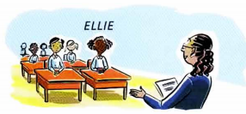
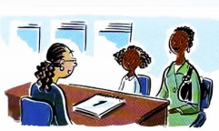

9 - Articles
Ellie is ten years old. Every day she goes to school. She's at school now. School starts at 9 and finishes at 3. We say a child goes to school or is at school (as a student). We are not thinking of a specific school. We are thinking of school as a general idea- children learning in a classroom.
Today Elli e's mother wants to speak to her daughter's teacher. So she has gone to the school to see her. She's at the school now. Ellie's mother is not a student. She is not 'at school', she doesn't 'go to school'. If she wants to see Ellie's teacher, she goes to the school (=Ellie's school, a specific building).
The
The

Slide 18
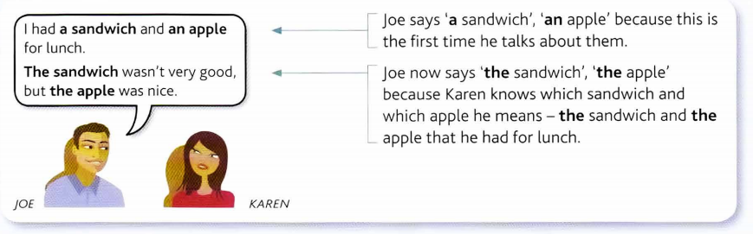

9 - Articles

Slide 19





What is the meaning of a sentence?
A sentence is a group of words that gives us an idea.
Compound
Complex
sentence
Compound
sentence
How many types are there in English?
Complex
sentence
Simple
sentence
There are four types of sentences

Slide 20
Simple Sentence.
A simple sentence has one subject and one predicate.
Pronoun
Verb
Prepositional phrase
We went to Baghdad yesterday.
Simple subject
Complete predicate
We go to Baghdad every Friday.
We will go to Baghdad next Friday.

Slide 21
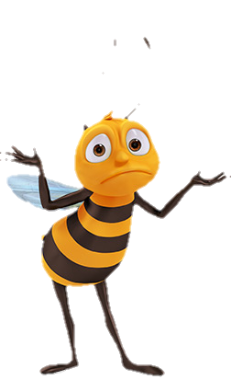

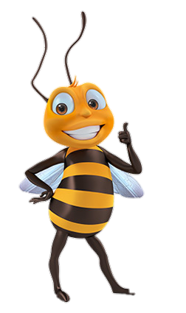

CASIO
How to write a paragraph
What is
a paragraph?
Parts
of a paragraph
Sample
of
a paragraph

Slide 22


What is a paragraph?
A paragraph is a piece of writing that consists of one or more than one sentence..

Slide 23
Parts of a Paragraph
A paragraph has three parts:
LEARNING
Topic Sentence
Supporting Sentences
Topic Sentence: It is usually the first sentence in a paragraph.
Supporting Sentences: They support the information of the topic sentence. It includes specific details
Conclusion: It reminds what the topic sentence was about.
Conclusion
EDUCATION

Slide 24
Diagram of any composition
Title
Topic
1
Supporting
2
Conclusion
3

Slide 25

PARAGRAPH SAMPLE:
My teacher
My teacher is Maysoon. She is my class teacher. She is strict, but funny.
She tells lots of jokes when she teaches. She teaches us a beautiful songs. She gives us sweets on her birthday and festivals. We all stay quiet when she speaks. She makes sure that we understand the subject very well. At the end of the class she asks us questions. Most of my friends also like her very much.
She is very beautiful and lovely. We wish her all good things in her life.
Compound sentence
She is strict. She is funny. = She is strict, but funny
She teaches us good songs. She gives us sweets on her birthday and festivals. We all stay quiet when she teaches. She makes sure that we understand the subject very well. At the end of the class she asks us questions. Most of my friends also like her very much. She is very beautiful and lovely. We wish her all good things in her life.
Red is the topic sentence
Blue is the supporting details
Black is the conclusion.

Slide 26

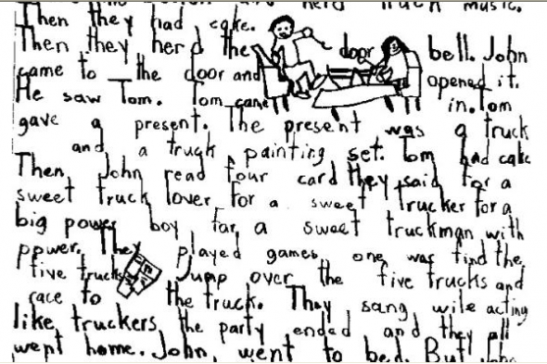
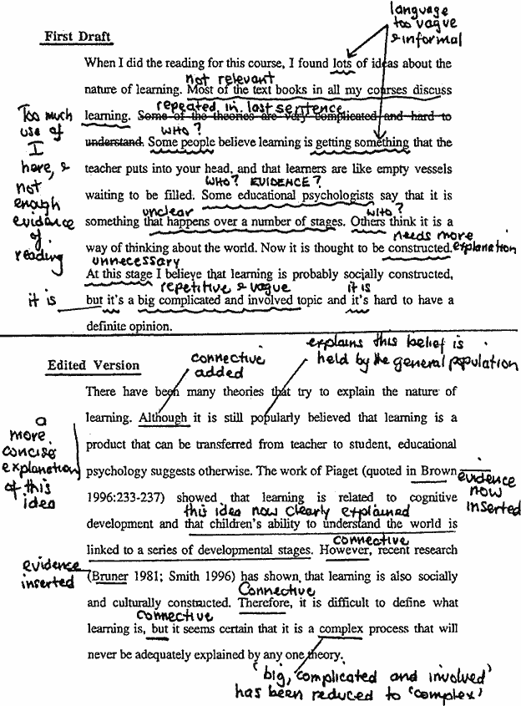
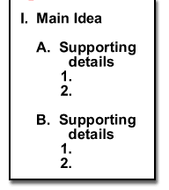
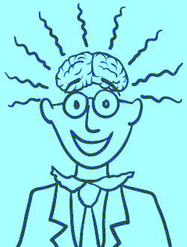
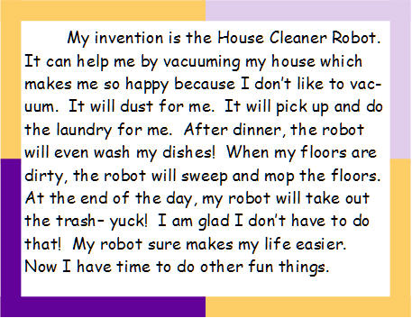
Brainstorming
In this step you should think and write down any idea about a topic you want to write about.
PROCESS TO WRITE A PARAGRAPH
There are five steps to write a good paragraph.
Order ideas
In this step you should organize your ideas by creating a cluster or an outline about what you want to write about.
WRITING THE FIRST DRAFT
In this step you should write your paragraph for the first time, not taking much into account about the grammar, or spelling.
FINAL WORK
In this step you should revise all the spelling or grammar errors. And that’s it. Your paragraph is done !
EDITING
In this step you should revise all the errors that your paragraph may have.
1
4
2
5
3

Slide 27
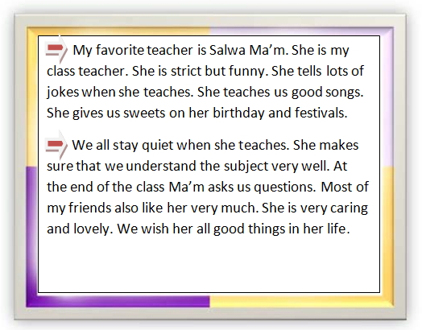
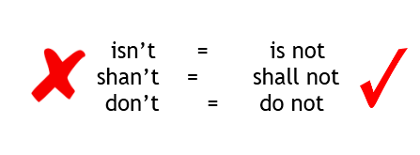
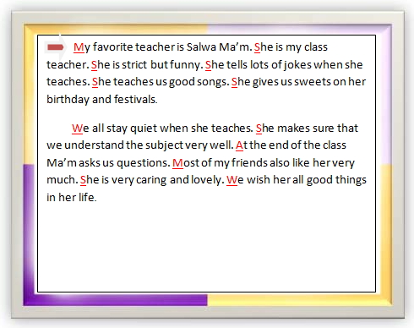
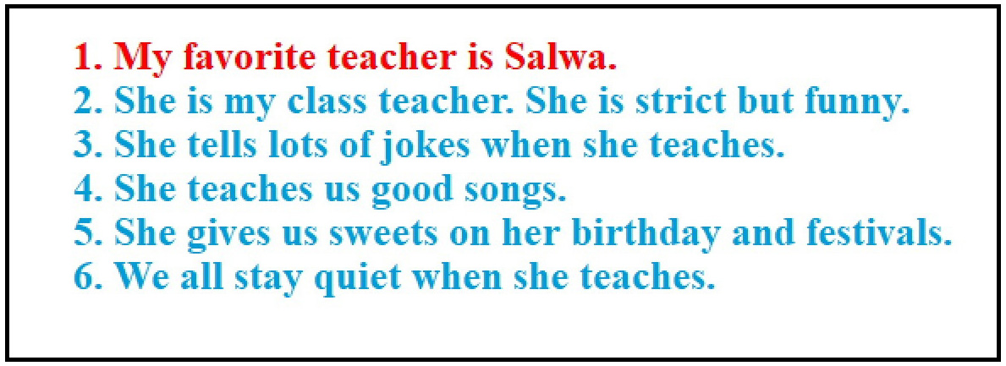
Some of rules that you should follow before start your writing.
In this step you should leave 3 – 5 spaces before every paragraph.
Indent
In this step you must use capital letter at the beginning of every sentence.
Capital letter
Point form
In this step you must not use point form sentences.
In this step you must not use contraction
like this way.
Contraction

Slide 28



CV
Punctuation marks
CV
CASIO
Colon
Semi-colon
Full stop
Comma
Apostrophe

Slide 29
Here is a guide to the rules for using the more common punctuation marks in English.
Full stop
When to use a full stop
At the end of the sentence
After initials in American English
As a decimal point
When to use commas in English
To separate items in a list, clauses
After yes & no …etc.
Maysoon needs coffee, tea, sugar, and milk.
Comma
We went out for the day; they stayed in.
Maysoon helps her mother every day.
The company‘s profits.
I don‘t like smoking.
(= do not)
The 10:40 train to London is late.
day; they
10:40
day..
coffee, tea, sugar, and
company‘s profits
don‘t
When to use colon in English
1.To introduce a list
2.To write the time
3.Between the title and subtitle of a book
Colon
Semi-colon
Semi-colons show a pause which is longer than a comma, but not as long as a full stop.
1. To separate long items in a list.
2. To give balance to sentences, or to link parallel sentences
Apostrophe
We use an apostrophe in English
1. With an s to show possession
2. To show abbreviation

Slide 30
Sample
SAMSUNG

Slide 31
A- Do you agree or disagree with the following statement? Technology has made the world a better place to live. Use specific reasons and examples to support your opinion .
B- How do movies or television influence people’s behavior? Use specific reasons and examples to support your answer.
Write a well – organized composition of about 200 -250 words about one of the following topics:

Slide 32
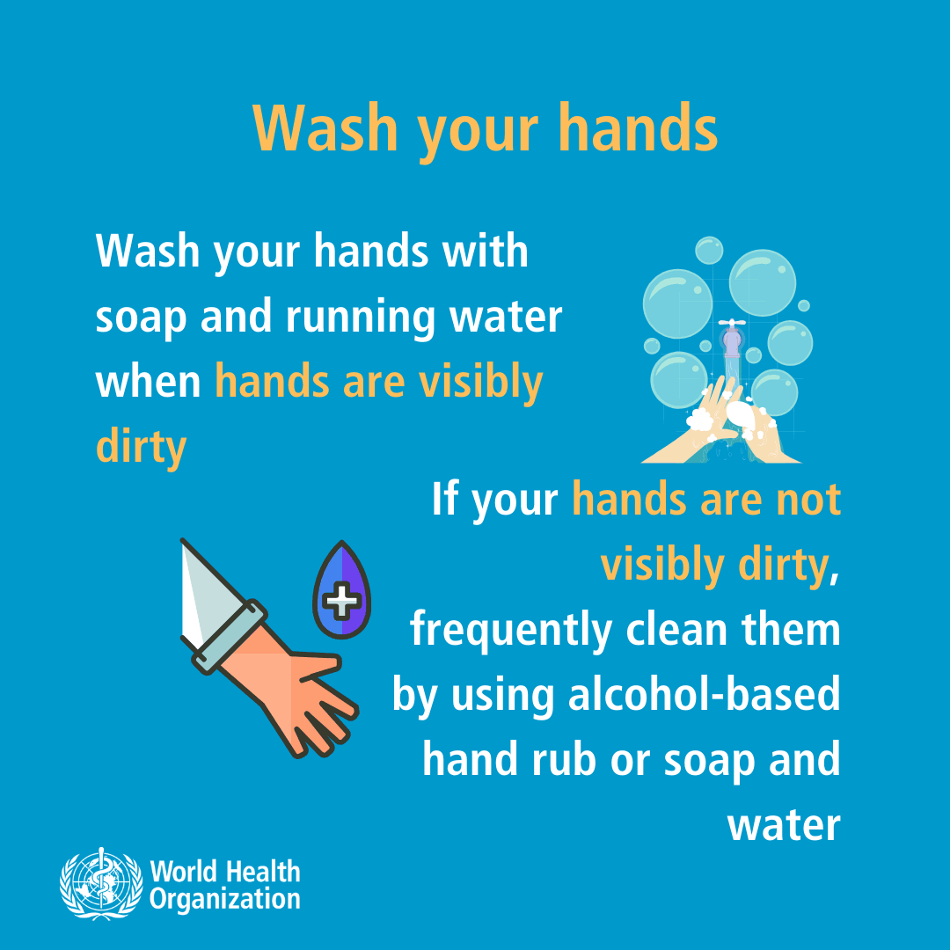






TOSHIBA
ممنوع التدخين
1
No smoking
3
5
4
2
G

