Slide 1
At a railway

Slide 2
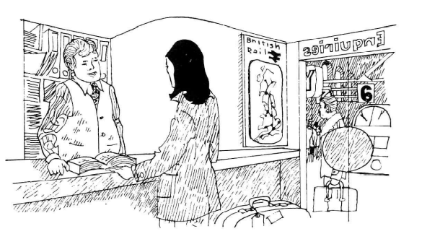
At a railway

Slide 3
At a railway
1st Person | When does the London train leave, please?
2nd Person | 9.25, Platform 3.
1st Person | What time does it reach London?
2nd Person | You should be there at 11.31, but you may be a bit late.
1st Person | Do I have to change?
2nd Person | Yes, you change at Lewis and East Croydon.

Slide 4
At a railway
1st Person | Which train do I take for Victoria, please?
2nd Person | 9.28. This end of Platform 2.
1st Person | When does it get in?
2nd Person | It gets there at 11.34.
1st Person | Must I change?
2nd Person | No, it's a *through train.

Slide 5
At a railway
1st Person | Which platform for London Bridge, please?
2nd Person | 9.27 from Platform 1.
1st Person | What time does it arrive?
2nd Person | It takes roughly two hours. So, you'll arrive just before 11.30.
1st Person | Is it necessary to change?
2nd Person | No, there's no need to change.

Slide 6
At a railway
1st Person | What time's the next train to Victoria, please?
2nd Person | 9.26, Platform 4. Right up at the front.
1st Person | When do we get there?
2nd Person | It's due in at 11.35, but they're running late today.
1st Person | Need I change trains?
2nd Person | Yes, change at East Croydon.

Slide 7
Some of useful idioms
Homophone
Homophones are words that have the same sound, in terms of how they are pronounced but have a different meaning and are (often) spelt differently.
Sally might say; “I’m going to the shops.”
Her brother, Richard might say; “I want to go too.”
And their mother might ask them; “Can you please get me two bananas?”

Slide 8
Some of useful idioms
Homophone
Word | Meaning |  | Word | Meaning
be | يكون |  | bee | نحلة
die | يموت |  | dye | صبغة
sea | بحر |  | see | يرى
write | يكتب |  | right | يمين
knight | فارس |  | night | ليل
meat | لحم |  | meet | يقابل / اجتماع
know | يعلم |  | no | لا

