Slide 1
التحليل العقدي المحاضرةالرابعة القيمة المطلقة او المعيار للعدد المركب لطلبة كلية التربية الاساسية/قسم الرياضيات / المرحلة الرابعة أعداد م.م. أنفال حسن ذياب

Slide 2
القیمة المطلقة (المعيار)
القیمة المطلقة للعدد المعقد Z = x + iyویرمز لھا بالرمز $\left|\text{Z}\right|$ هي $\sqrt{{\text{x}}^{2}+y^{2}}$=$\left|\text{Z}\right|$
مثال/
جد القیمة المطلقة للعدد Z = 3 + 4i
الحل / 5 = $\sqrt{{\text{3}}^{2}+4^{2}}$ = $\sqrt{{\text{x}}^{2}+y^{2}}$=$\left|\text{Z}\right|$
بعض خواص القیم المطلقة(المعیار)
$\overline{\text{Z}}$ Z = ${\left|\text{Z}\right|}^{2}$ $⇒$ $\overline{\text{Z}}$ Z =1) $\left|\text{Z}\right|$
$\left|\text{Z}\right|$= 2) $\left|\overline{\text{Z}}\right|$

Slide 3
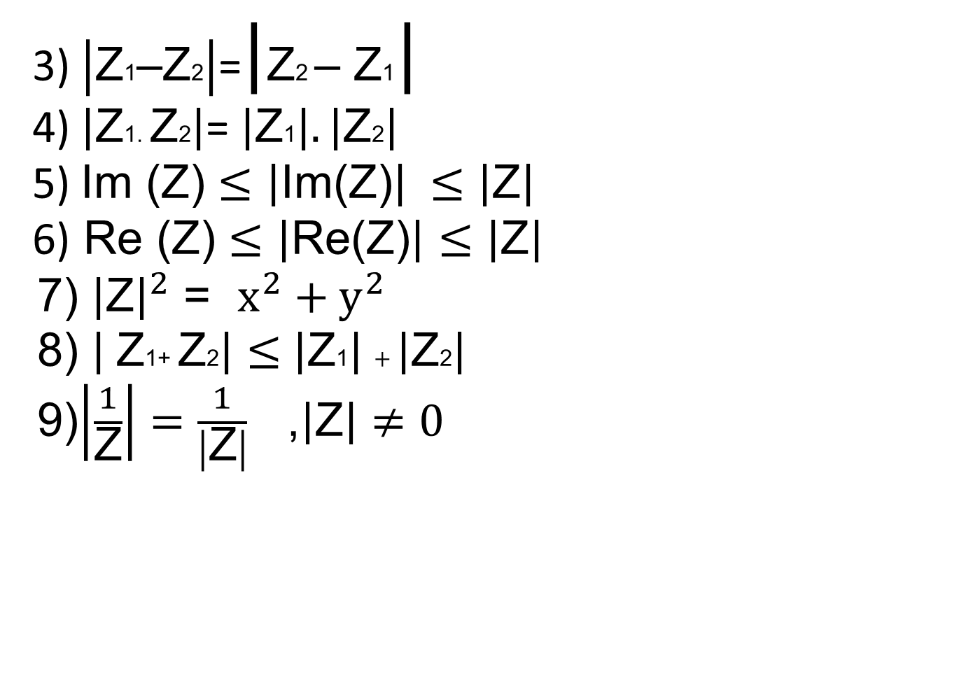
3) $\left|\text{Z}\text{1}\text{–}\text{Z}\text{2}\right|$=$\left|\text{Z}\text{2 }\text{– }\text{Z}\text{1}\right|$
4) $\left|\text{Z}\text{1}\text{. }\text{Z}\text{2}\right|$= $\left|\text{Z}\text{1}\right|. \left|\text{Z}\text{2}\right|$ 5) Im (Z) $≤$ $\left|\text{Im}\text{(}\text{Z}\text{)}\right| ≤$ $\left|\text{Z}\right|$
6) Re (Z) $≤$ $\left|\text{Re}\text{(}\text{Z}\text{)}\right|≤$ $\left|\text{Z}\right|$
$x^{2}+y^{2}$ = 7) ${\left|\text{Z}\right|}^{2}$
$\left| \text{Z}\text{1}\text{+ }\text{Z}\text{2}\right|≤$ $\left|\text{Z}\text{1}\right|+\left|\text{Z}\text{2}\right|$ 8)
9)$\left|\frac{1}{\text{Z}}\right|=\frac{1}{\left|\text{Z}\right|}$ ,$\left|\text{Z}\right|≠0$

Slide 4
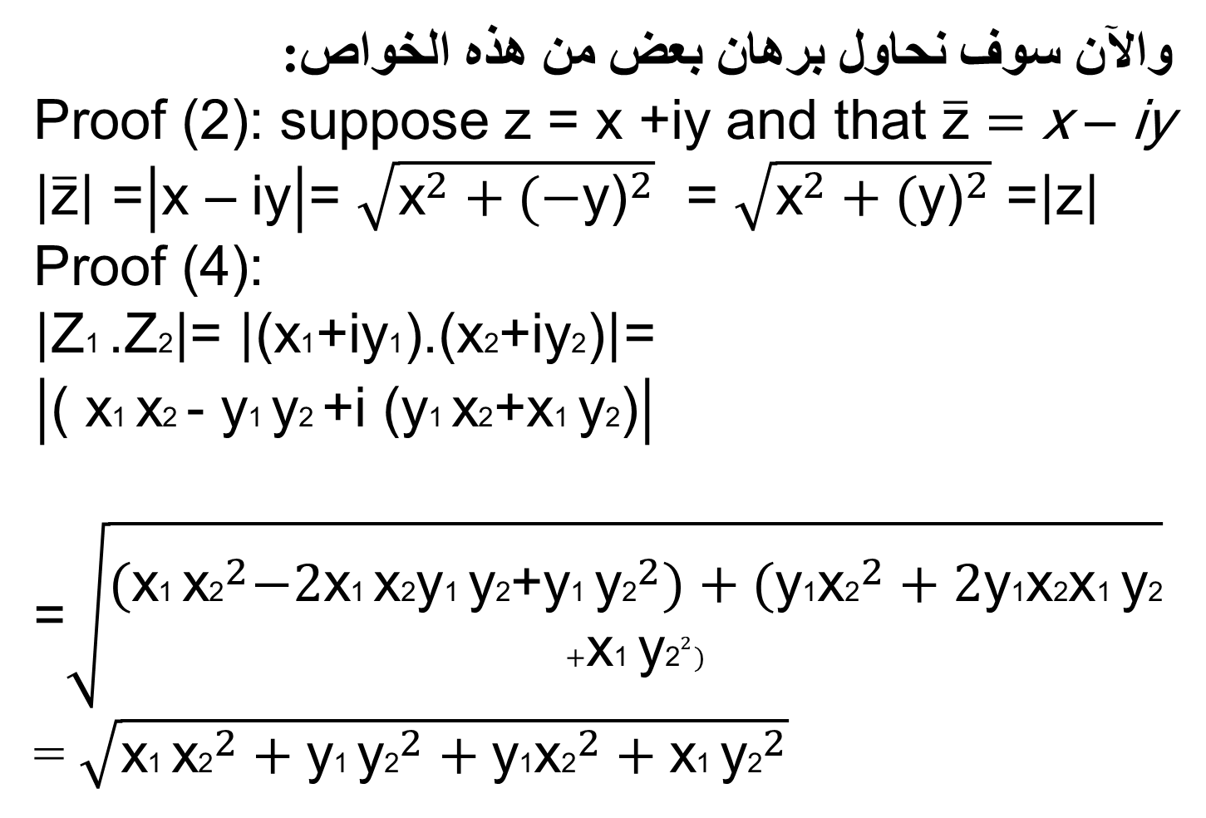
والآن سوف نحاول برھان بعض من ھذه الخواص:
$\overline{\text{z}}=$ x – iy Proof (2): suppose z = x +iy and that
$\left|\overline{\text{z}}\right|$ =$\left|\text{x}\text{ – }\text{iy}\right|$= $\sqrt{{\text{x}}^{2}+{\text{(−}\text{y}\text{)}}^{2}}$ = $\sqrt{{\text{x}}^{2}+{\text{(}\text{y}\text{)}}^{2}}$ =$\left|\text{z}\right|$
Proof (4):
$\left|\text{Z}\text{1 }\text{.}\text{Z}\text{2}\right|$= $\left|\text{(}\text{x}\text{1}\text{+}\text{iy}\text{1}\text{).(}\text{x}\text{2}\text{+}\text{iy}\text{2}\text{)}\right|$=
$\left|\text{( }\text{x}\text{1 }\text{x}\text{2 }\text{− }\text{y}\text{1 }\text{y}\text{2 }\text{+}\text{i}\text{ (}\text{y}\text{1 }\text{x}\text{2}\text{+}\text{x}\text{1 }\text{y}\text{2}\text{)}\right|$
=$\sqrt{\begin{aligned}{\text{(}\text{x}\text{1 }\text{x}\text{2}}^{2}−2\text{x}\text{1 }\text{x}\text{2}\text{y}\text{1 }\text{y}\text{2}\text{+}{\text{y}\text{1 }\text{y}\text{2}}^{2})+({\text{y}\text{1}\text{x}\text{2}}^{2}+2\text{y}\text{1}\text{x}\text{2}\text{x}\text{1 }\text{y}\text{2} \\ +{\text{x}\text{1 }\text{y}\text{2}}^{2})\end{aligned}}$
$\sqrt{{\text{x}\text{1 }\text{x}\text{2}}^{2}+{\text{y}\text{1 }\text{y}\text{2}}^{2}+{\text{y}\text{1}\text{x}\text{2}}^{2}+{\text{x}\text{1 }\text{y}\text{2}}^{2}}$ =

Slide 5
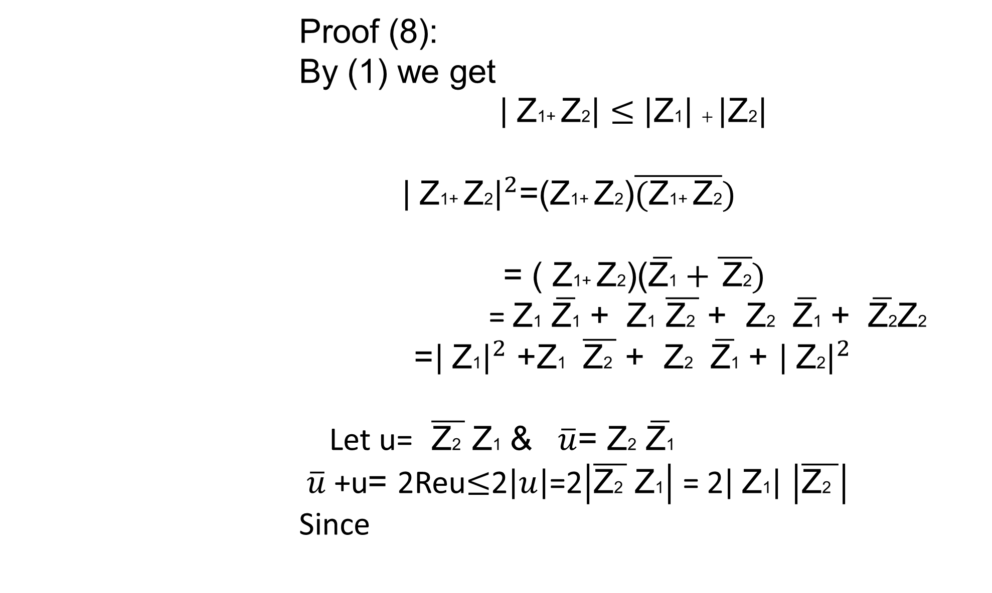
Proof (8):
By (1) we get
$\left| \text{Z}\text{1}\text{+ }\text{Z}\text{2}\right|≤$ $\left|\text{Z}\text{1}\right|+\left|\text{Z}\text{2}\right|$
${\left| \text{Z}\text{1}\text{+ }\text{Z}\text{2}\right|}^{2}$=($\text{Z}\text{1}\text{+ }\text{Z}\text{2}$)$\overline{(\text{Z}\text{1}\text{+ }\text{Z}\text{2}})$
$\text{Z}\text{1}\text{+ }\text{Z}\text{2}$)($\overline{\text{Z}\text{1}}+\overline{ \text{Z}\text{2}})$ = (
$\overline{\text{Z}\text{2}}\text{Z}\text{2}$ + $\overline{\text{Z}\text{1}}$ $\text{Z}\text{2}$ + $\overline{\text{Z}\text{2} }$ $\text{Z}\text{1}$ + $\overline{\text{Z}\text{1}}$ = $\text{Z}\text{1}$
${\left| \text{Z}\text{2}\right|}^{2}$ + $\overline{\text{Z}\text{1}}$ $\text{Z}\text{2}$ + $\overline{\text{Z}\text{2} }$ $\text{Z}\text{1}$ + ${\left| \text{Z}\text{1}\right|}^{2}$=
$\overline{\text{Z}\text{1}}$ $\text{Z}\text{2}$ $\overline{u}$= & $\overline{\text{Z}\text{2} }$ $\text{Z}\text{1}$ Let u=
$\left|\overline{\text{Z}\text{2} }\right|$ 2Reu$≤$2$\left|u\right|$=2$\left|\overline{\text{Z}\text{2} } \text{Z}\text{1}\right|$ = 2$\left| \text{Z}\text{1}\right|$ = $\overline{u}$+u
Since

Slide 6

${\left| \text{Z}\text{2}\right|}^{2}$ + $\overline{\text{Z}\text{1}}$ $\text{Z}\text{2}$ + $\overline{\text{Z}\text{2} }$ $\text{Z}\text{1}$ + ${\left| \text{Z}\text{1}\right|}^{2}$ ${\left| \text{Z}\text{1}\text{+ }\text{Z}\text{2}\right|}^{2}$=
$$≤{\left| \text{Z}\text{2}\right|}^{2}\text{ +}\text{2}\left| \text{Z}\text{1}\right|\left|\overline{\text{Z}\text{2} }\right|\text{+} {\left| \text{Z}\text{1}\right|}^{2}$$
$$≤{({\left| \text{Z}\text{2}\right|}^{2}+{\left| \text{Z}\text{1}\right|}^{2})}^{2}$$
By take the root we get
$\left| \text{Z}\text{1}\text{+ }\text{Z}\text{2}\right|≤$ $\left|\text{Z}\text{1}\right|+\left|\text{Z}\text{2}\right|$

