Slide 1
The Theory of Computation النظرية الاحتسابية
المحاضرة رقم -9-
Treesالاشجار
إعداد
م.م وديان حبيب حميد
كلية التربية الاساسية / قسم الحاسبات

Slide 2
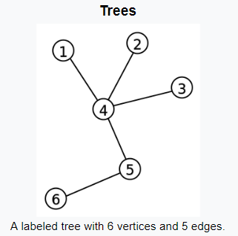
TREES
رسم بياني متزامن لا يحتوي على دورات. المسار بين أي عقدتين في الشجرة فريد.:Free tree
: هو طول المسار في الشجرة ما بين اي عقد والجذر.The depth
: هو طول أطول مسار من الجذر. The height of tree
اذا كانت جميع أوراقها ضمن نفس المستوى.Balancedتكون الشجرة متوازنة

Slide 3
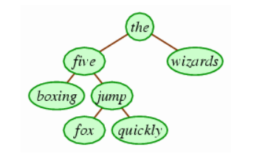
Example1: the five boxing wizards jump quickly.

Slide 4
Tree Terminology مصطلحات الشجرة
Root: node without parent (A)
Siblings: nodes share the same parent
Internal node: node with at least one child (A, B, C, F)
External node (leaf ): node without children (E, I, J, K, G, H, D)
Ancestors of a node: parent, grandparent, grand-grandparent, etc.
Descendant of a node: child, grandchild, grand-grandchild, etc.
Depth of a node: number of ancestors
Height of a tree: maximum depth of any node (3)
Degree of a node: the number of its children
Degree of a tree: the maximum number of its node.

Slide 5
Tree Terminology مصطلحات الشجرة
Subtree: tree consisting of a node and its descendants
A
B
C
D
E
F
G
H
I
J
K

Slide 6
Tree Properties خصائص الشجرة
Property Value
Number of nodes
Height
Root Node
Leaves
Interior nodes
Ancestors of H
Descendants of B
Siblings of E
Right subtree of A
Degree of this tree
A
B
C
D
E
F
G
H
I

Slide 7
Intuitive Representation of Tree Node
List Representation
( A ( B ( E ( K, L ), F ), C ( G ), D ( H ( M ), I, J ) ) )
The root comes first, followed by a list of links to sub-trees
How many link fields are needed in
such a representation?
Data
Link 1
Link 2
…
Link n

Slide 8
Tree Traversal
Two main methods:
Preorder
Postorder
Recursive definition
Preorder:
visit the root
traverse in preorder the children (subtrees)
Postorder
traverse in postorder the children (subtrees)
visit the root

Slide 9
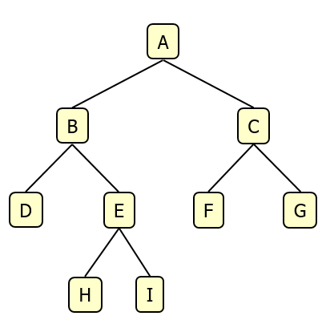
Binary Tree الشجرة الثنائية
A binary tree is a tree with the following properties:
Each internal node has at most two children (degree of two)
The children of a node are an ordered pair
We call the children of an internal node left child and right child
Alternative recursive definition: a binary tree is either
a tree consisting of a single node, OR
a tree whose root has an ordered pair of children, each of which is a binary tree
Applications:
arithmetic expressions
decision processes
searching

Slide 10
Examples of the Binary Tree
Skewed Binary Tree
Complete Binary Tree
A
A
A
B
B
B
C
C
D
E
F
G
D
H
I
E

