Slide 1
How to write a paragraph…
Presented by
Asst. Inst. Hazim Mohamed Ali
College of Basic Education,
University of Diyala
2019 - 2020

Slide 2
Welcome everybody
5
4
3
2
1

Slide 3
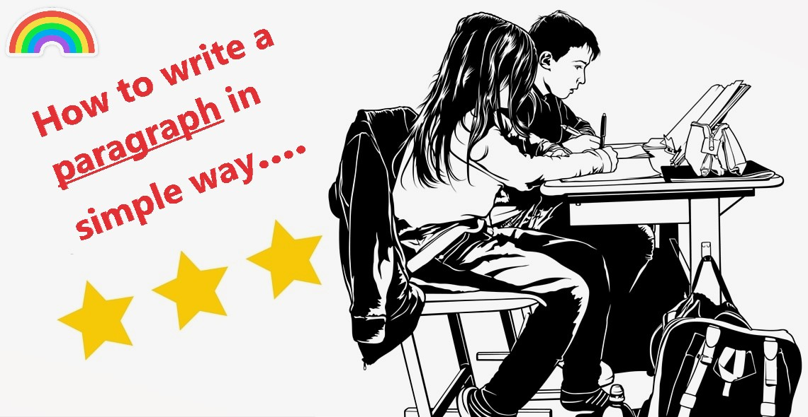

Slide 4
The Nine Parts of Speech
5
4
6
Article
--------------------
This is a book.
This is an apple.
These are the books.
This is the book.
3
7
Interjection
--------------------
How, what
How hot day it was!
Pronoun
--------------------
I, he, she, it, they, we, you.
Adverb
--------------------
Slowly, usually, ago…… etc
Conjunction
--------------------
For, and, so, yet, but, that, or…… etc
Noun
--------------------
Ali, Suha, teacher, Iraq, door, snake….etc.
Verb
--------------------
Play, write , open, walk, wash… etc.
Preposition
--------------------
In, on, at, to…… etc
Adjective
--------------------
Good, smart, clever, red, Iraqi, big..etc
2
8
1
9

Slide 5




What is the meaning of a sentence?
A sentence is a group of words that gives us an idea.
Compound
Complex
sentence
How many types are there in English?
Compound
sentence
Complex
sentence
Simple
sentence
There are four types of sentences

Slide 6
Simple Sentence.
A simple sentence has one subject and one predicate.
Pronoun
Verb
Prepositional phrase
We went to Baghdad yesterday.
Simple subject
Complete predicate
We go to Baghdad every Friday.
We will go to Baghdad next Friday.

Slide 7




How to write a paragraph
CASIO
What is
a paragraph?
Parts
of a paragraph
Sample
of a paragraph

Slide 8

What is a paragraph?
A paragraph is a piece of writing that consists of one or more than one sentence..

Slide 9
Parts of a Paragraph
A paragraph has three parts:
LEARNING
Topic Sentence
Supporting Sentences
Topic Sentence: It is usually the first sentence in a paragraph.
Supporting Sentences: They support the information of the topic sentence. It includes specific details
Conclusion: It reminds what the topic sentence was about.
Conclusion
EDUCATION

Slide 10
Diagram of any composition
Title
Topic
1
Supporting
2
Conclusion
3

Slide 11

PARAGRAPH SAMPLE
My teacher
My favorite teacher is Salwa. She is my class teacher. She is strict, but funny. She tells lots of jokes when she teaches. She teaches us good songs. She gives us sweets on her birthday and festivals. We all stay quiet when she teaches. She makes sure that we understand the subject very well. At the end of the class she asks us questions. Most of my friends also like her very much. She is very beautiful and lovely. We wish her all good things in her life.
Red is the topic sentence
Blue is the supporting details
Black is the conclusion.

Slide 12

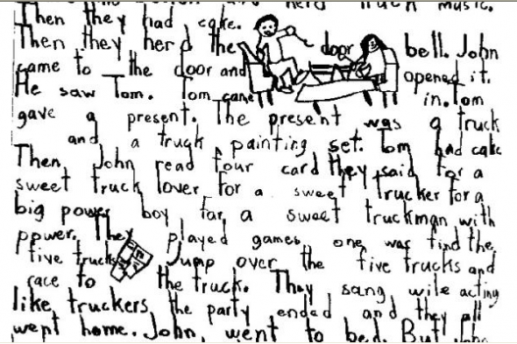
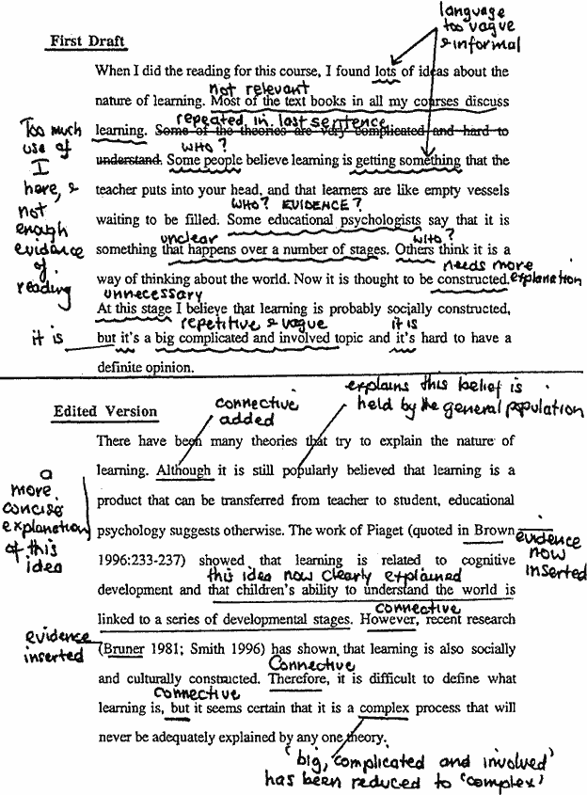

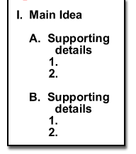
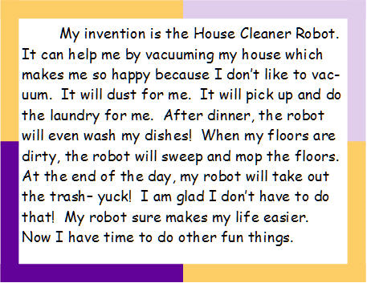
Brainstorming
In this step you should think and write down any idea about a topic you want to write about.
PROCESS TO WRITE A PARAGRAPH
There are five steps to write a good paragraph.
Order ideas
In this step you should organize your ideas by creating a cluster or an outline about what you want to write about.
WRITING THE FIRST DRAFT
In this step you should write your paragraph for the first time, not taking much into account about the grammar, or spelling.
FINAL WORK
In this step you should revise all the spelling or grammar errors. And that’s it. Your paragraph is done !
EDITING
In this step you should revise all the errors that your paragraph may have.
1
4
2
5
3

Slide 13

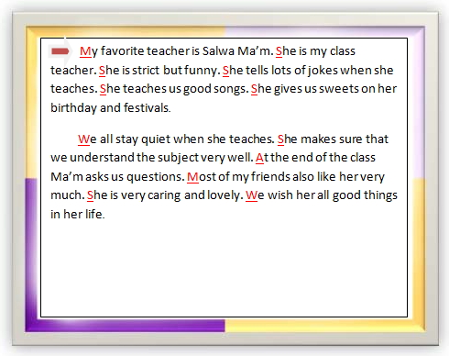
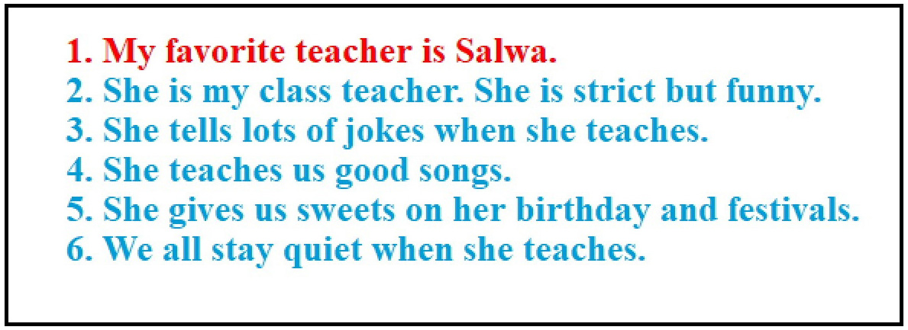
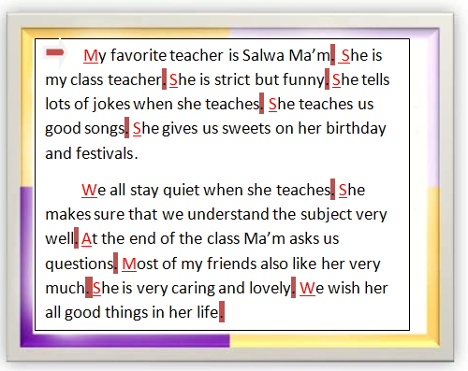
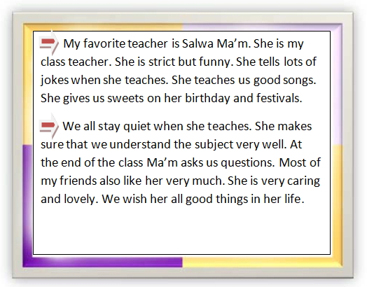
Some of rules that you should follow before start your writing.
In this step you should leave 3 – 5 spaces before every paragraph.
Indent
In this step you must use capital letter at the beginning of every sentence.
Capital letter
Use period
In this step you must use period at the end of every sentence.
Point form
In this step you must not use point form sentences.
In this step you must not use contraction
like this way.
Contraction

Slide 14
Sample
SAMSUNG

Slide 15
A- Do you agree or dis agree with the following statements? Technology has made the world a better place to live. Use specific reasons and examples to support your opinion .
B- How do movies or television influence people’s behavior? Use specific reasons and examples to support your answer.
Write a well – organized composition of about 200 -250 words about one of the following topics:

Slide 16



1
2

