Slide 1
Let’s speak together

Slide 2
Answer the following

Slide 3
1. What’s your name ? 2. What are you ? Do you like it ? 3. Where do you work ? How is it ? 4. What’s your favorite color ? 5. Do you have a family ? Sisters , brothers.. 6. Do you have hobbies ? 7. Do you listen to music ? Kind ? 8. Do you watch T.V. ?

Slide 4
Hello there, my name is Zaid. I come from Baghdad and I’m actually a student of foreign languages at the University, but I’m also interested in the world of “teaching”, because we can learn better by teaching. Also, I always spend time reading books.

Slide 5
Hi everybody! my name is Hadi. I’ve been teaching for 15 years, but I’m still a student, learning so much from people, and from my students. What to learn? I observe very much people in their behaviour. Smiling is a way of turning everything pink, even if it is black. Some of my students call me the ever smiling teacher…..

Slide 6
Hi, my name is Luma. I am a teacher, but I must confess that usually, the position that I feel good is that of a student. First of all, I’m here to know your life stories. I am convinced that all barriers that history has drawn in our mind and our soul will be overcome by an act of the utmost freedom to feel us together first as “mankind

Slide 7
Good day to you all. My name is Nuha. For many years I’m a teacher. And now, I’m also a student!. So if you ask me what I do all week. It’s working, studying, being a father of two super kids, and spending time with friends. You’re never too old to learn is my motto, and especially the learning of other peoples experience. All the good things we should share and learn from it! So let’s get started together!!

Slide 8
Interview

Slide 9
Interview 1. What’s your name ? 2. What are you ? 3. Do you like your job ? Why ? 4. When do you come to your job ? 5. How do you come ?

Slide 10
Interview 1. What’s your name ? 2. What are you ? 3. Do you have friends ? 4. Who are they ? 5. How do you spend your time after job ? 6. Do you like shopping ? Why ?

Slide 11
Interview 1. Do you like travelling ? Why ? 2. Give me the name of two places you have visited ? 3. Do you like music ? What kind ? 4. Do you like reading ? What kind ?

Slide 12
What does the picture mean ?

Slide 15
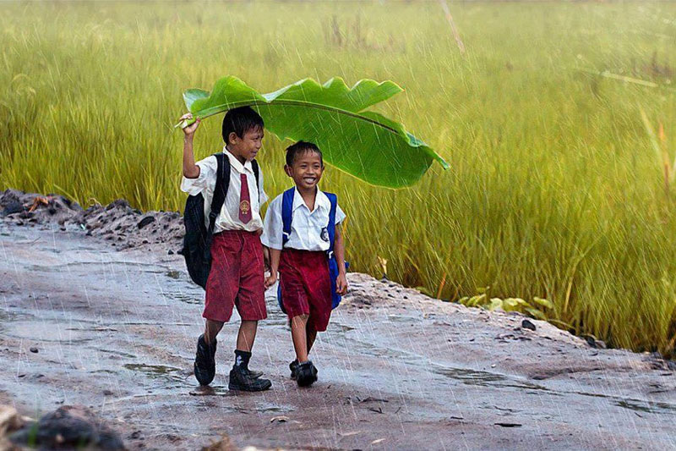

Slide 29
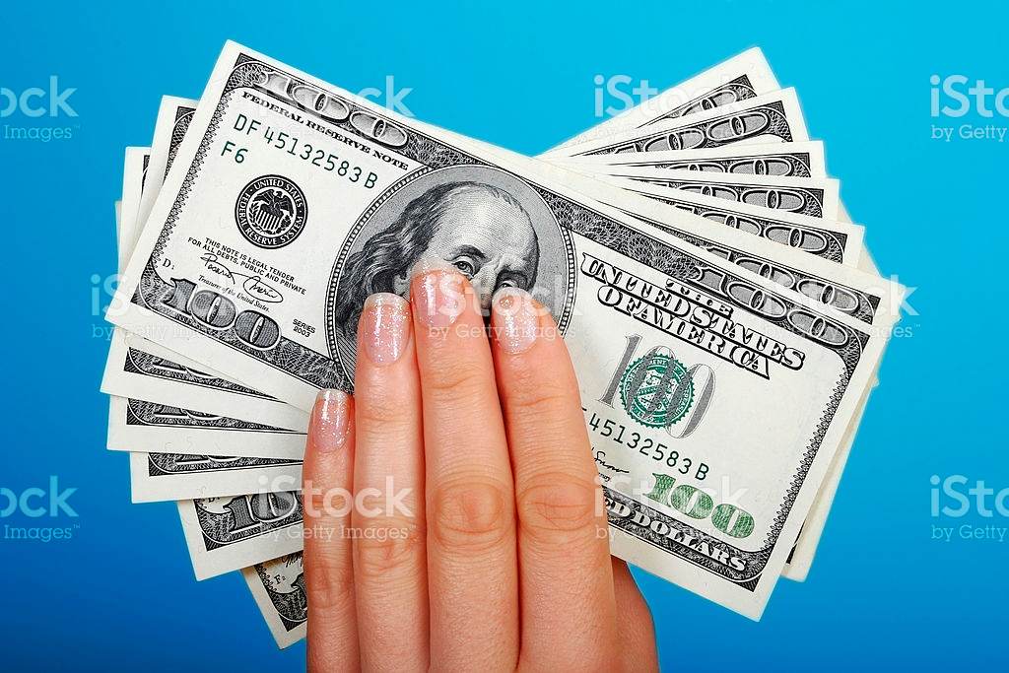

Slide 30
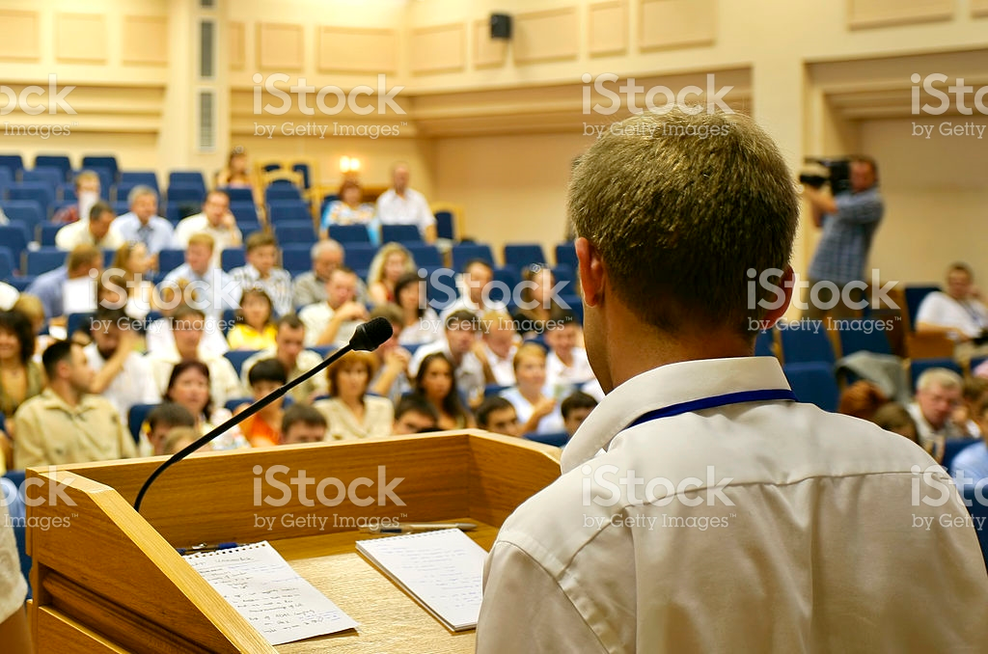

Slide 31
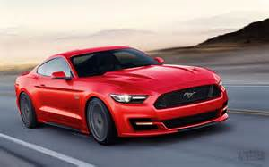

Slide 32
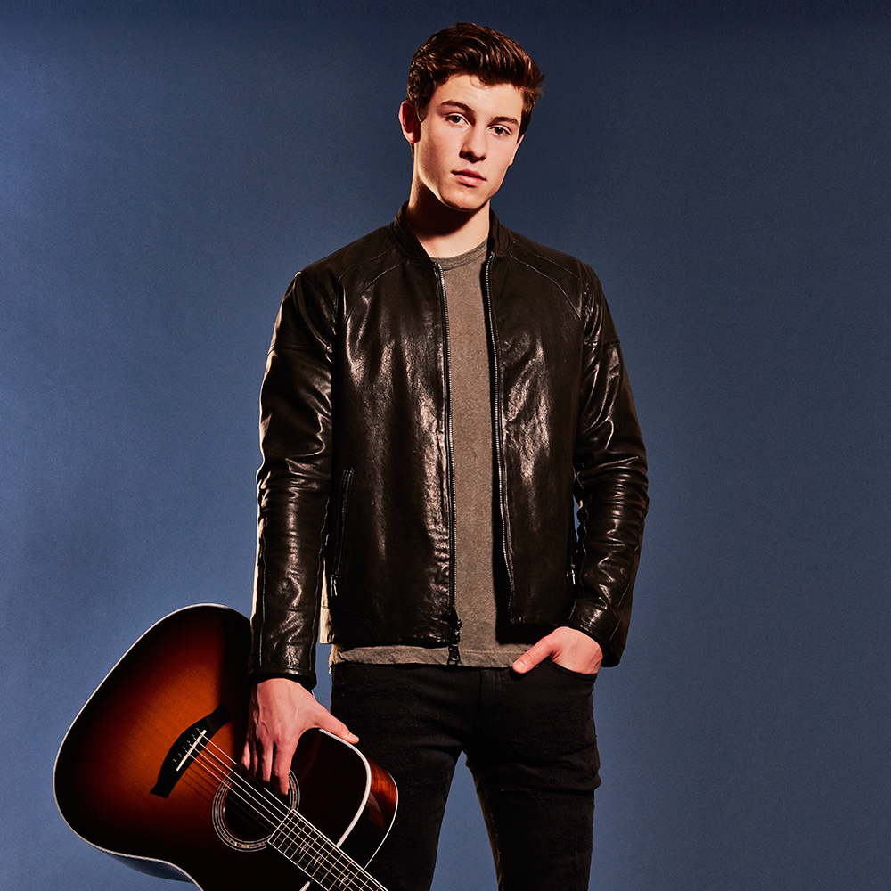

Slide 33
Any Question ?

