Slide 1
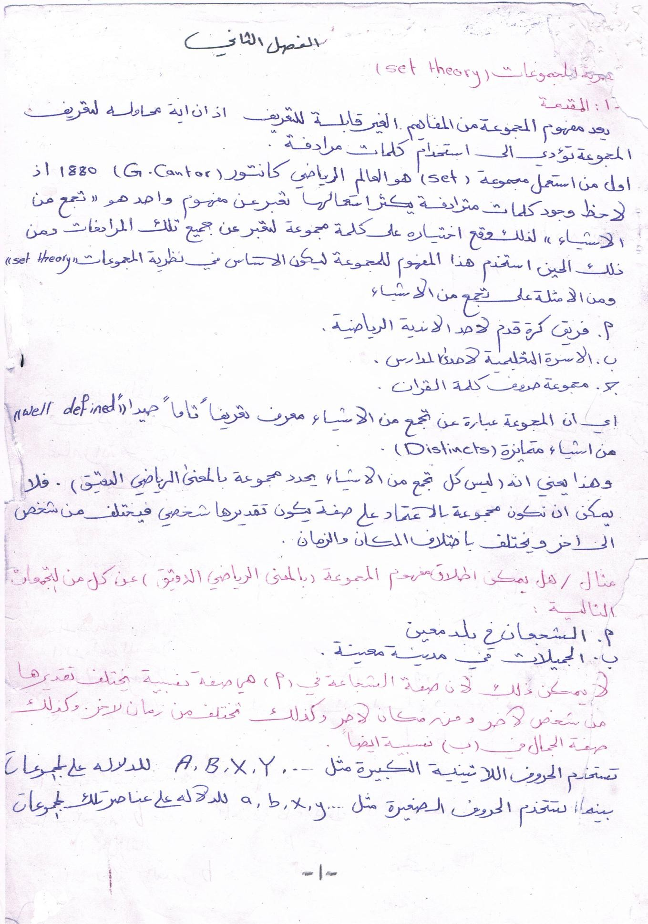
Assistant prof. Dr. Feryal. K. D Mathematical logic
1

Slide 2
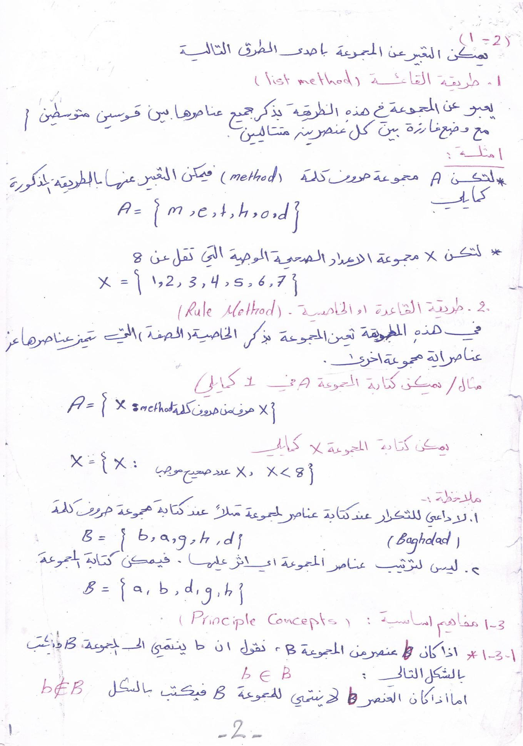
Assistant prof. Dr. Feryal. K. D Mathematical logic
2

Slide 3
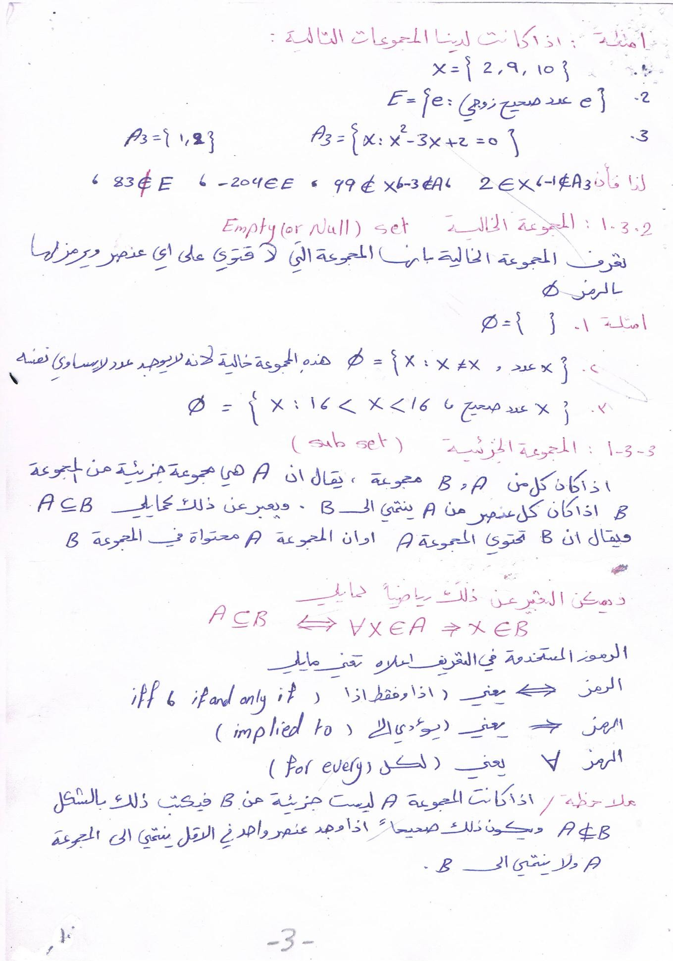
Assistant prof. Dr. Feryal. K. D Mathematical logic
3

