Slide 1
Oral Communication
Presented by
Dr. Maysaa R. Jewad
College of Basic Education/ Diyala University

Slide 2
Some Basic Personal Information
What’s Your name?
- My name is ……
How old are you?
- Iam 25 years old.
What’s your marital status?/ Are you married?
I am single ( or married) / Yes, I amor No, Iam not.

Slide 3
Personal Information
Where do you live? What’s you address?
- I live in Diyala, Baquba, Mu’alimeen QTR 402, st. 72, H.No. 22.
What’s your nationalty?
I am Iraqi/ Egyptian/ Moroccan/ Lebanese, Kuwaiti / Indian/ American/ British/Chinese/ Spanish/ Japanese… etc.

Slide 4
Greetings
Good Morning/Afternoon/ Evening/ Night
How are you=How are you doing= How is it going with you= What’s up= Howdy= how is life treating you?
Have a great(good) day/ night/ time
Have a nice trip.
See you soon/ tomorrow/ next week …etc.

Slide 5
Talking about the weather
Nice weather isn’t it? جو لطيف أليس كذألك
or Nice) terrific, beautiful( view, isn’t it?
It’s cloudy/ rainy/ decimal/ sunny …etc.
Some useful vocabularies:

Slide 6
At the Restaurant
waiter : Would you like to order now ?
Customer : Yes I'd like a chicken and vegetable salad please
Waiter : Sure anything else ?
Customer : Yes , can I have a cheese burger and chips , please?
Waiter: Yes of course. And what would you like to drink ?
Customer : coke and mineral water, please .
Waiter : Yes of course . Would you like to desert ?
Customer : Yes, I'd like an apple pie and ice cream.
Waiter : You order me sir . anything else ?

Slide 7
At the Restaurant
Customer: No , thank you, but can we have the bill please ?
Waiter: certainly , its 95$ in total .
Customer :Here's 100$ , you can keep the 5$ as a tip.
Waiter: Thank you sir .

Slide 8
At the Airport
Employee : Can I have your ticket & passport , please ?
نعم تفضلPassenger: yes here you are
Employee : How many bags have you got ?
Passenger : Two bags.
Employee : Did you pack your bags yourself ?
هل انت رزمت حقائبك؟
passenger: yes I did .
Employee: Have you got any sharp Items in your hand bag?
الحقيبة اليدوية التي تحمل مع المسافر داخل الطائرة

Slide 9
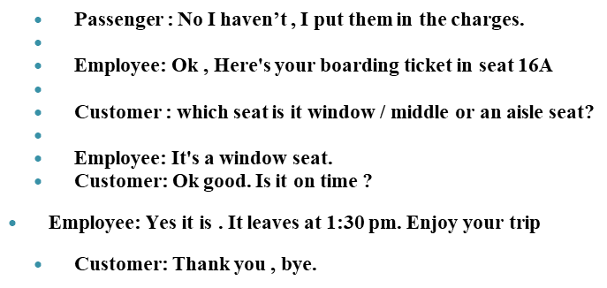
At the Airport (2)

Slide 10
Conversation Topics
Weather- Sport- Entertainment
Hobbies- Books- Time
Hometown- Travel – Studies/Major
Food- Fashion- News
At the Airport
At the Restaurant
At the Doctors’
At the Shop/ Supermarket

Slide 11
Strategies:
Read the entire question.
Answer it in Your mind First.
Eliminate Wrong answers
Select the best answer
Read every answer option
Make an educated guess
Choose the right answer

Slide 12
Some common Vocabularies
Weather: cloudy, stormy , humid, dry, rainy, dusty, foggy, windy, cold, hot.
Sports: football, volleyball, baseball, golf, swimming, skiing, swimming, tennis, baseball
Entertainment: Reading, writing, Travelling, swimming, hunting, drawing, playing+ any game or sport

Slide 13
Questions
Describe your best friend. What do you like most about him/her?
Handsome/ beautiful/ gorgeous
Generous
Clever- smart, intelligent
Loyal, faithful
Optimistic vs. Pessimistic
Kind, merciful, generous, vs. miser

Slide 14
Match the Questions and Answers
1. Where are you from? a. His name’s Brad.
2.What’s her name? b. He’s from Jorden
3. What’s his name? c. It’s in Canada.
4. Where’s he from? d. I’m from Turkey.
5. How are you? e. Her name’s Tara.
6.What’s this in English? f. It’s a computer
7. Where’s Montreal? g. It’s a computer

Slide 15
Choose the best answer:
My brother’s …… He works in a small French restaurant. (a. a waiter b. a shop assistant c. a secretary)
Please ……. The piano now. The children are asleep.
(a. don’t play b. no play c. not to play)
My brother likes Madona, but he … Shakera.
( a. likes b. don’t like c. doesn’t like)
Where …………………?
(a. do you work b. You do work c. you work …
What do you say if someone said to you. “Thanks very much”? ……………..

Slide 16
Situational Conversations Sample 1
Ali: did Sally go to the bank this morning?
Hasan: Yes she did, she got a new checking account.
What does Hasan imply?
Sally wanted to check up on the bank.
Sally wrote several checks.
a new checking account was opened.
Sally checked on the banlance in her account.

Slide 17
Sample 2
Tom: This weather is killing me. I can’t breathe.
Tanya: I thought you liked hot weather.
What do you infer from this conversation?
A. Tom is upset because of the weather.
B. the weather is very cold.
C. Tanya likes the hot weather
D. Tom is comfortable with the waether.

Slide 18
Sample 3
Sami: Billy really made a big mistake this time.
Noor: Yes, he forget to turn in his research paper.
What does Noor say about Billy?
A. It was the first time he made a mistake.
B. He forgot to write his paper.
C. he turned in the paper in the wrong place.
D. he did not remember to submit his assignment.

Slide 19
Some useful Terms in Situational Conversations
Suggest يقترح
Imply يشير الى – يتضمن
Refer to يشير الى
Say يقول
Mean يقصد
Infer يستنتج

Slide 20
End of the Lecture
Thanks
Wish You All the Success

