Slide 1
READING COMPREHENSION WORKSHEETS INFOGRAPHICS
Here is where this template begins

Slide 2
ABOUT READING COMPREHENSION WORKSHEETS INFOGRAPHICS
This template contains an assortment of complementary infographic resources for the Reading Comprehension Worksheets Multi-purpose presentation.
These infographics are adapted to the style of the aforementioned presentation, so you can insert them easily and have them completely integrated at once. You just need to do the following:
Select the element that you want to copy
Right-click and choose “Copy”
Go to the slide where you want the element to appear
Right-click and choose “Paste”

Slide 3
READING COMPREHENSION WORKSHEETS
Read the title
Read the story
Underline words
Look for definitions
Jupiter is a gas giant and the biggest planet
Mercury is the closest planet to the Sun
Venus has a nice name but is a very hot place
Pluto is considered a dwarf planet

Slide 4
READING COMPREHENSION WORKSHEETS
Mercury is the closest planet to the Sun
01
Comprehension
02
Phonemic awareness
Reading skills
03
Phonics
04
Fluency
Jupiter is a gas giant and the biggest planet
05
Vocabulary

Slide 5
READING COMPREHENSION WORKSHEETS
Accuracy
Jupiter is a gas giant and the biggest planet
What’s fluency?
Reading speed
Prosody
Venus has a nice name but is a very hot place
Mercury is the closest planet to the Sun

Slide 6
READING COMPREHENSION WORKSHEETS
Reading comprehension
Make Connections
Text to self
Jupiter is a gas giant and the biggest planet of them all
Venus has a nice name but is a very hot place
Test to text
Text to world
Mercury is the closest planet to the Sun
Pluto is now considered a dwarf planet

Slide 7
READING COMPREHENSION WORKSHEETS
Reading is good for you
Physical health
Empathy with others
Mental health
Jupiter is a gas giant and the biggest planet
Mercury is the closest planet to the Sun
Venus has a nice name but is a very hot place

Slide 8
READING COMPREHENSION WORKSHEETS
Reading strategies
01 | Predict | Mercury is the closest planet to the Sun
02 | Visualize | Venus is the second planet from the Sun
03 | Question | Earth is the third planet from the Sun
04 | Connect | Despite being red, Mars is very cold
05 | Identify | Jupiter is the biggest planet in the Solar System
06 | Infer | Saturn is a gas giant and has several rings

Slide 9
READING COMPREHENSION WORKSHEETS
55%
45%
Jupiter
Mercury
Jupiter is a gas giant and the biggest planet
Mercury is the closest planet to the Sun

Slide 10
READING COMPREHENSION WORKSHEETS
3 reading strategies
3
2
Questioning
1
Modelling
Pluto is considered a dwarf planet
Earth is the third planet from the Sun
Annotating
Saturn is a gas giant and has several rings
Despite being red, Mars is a cold place
Jupiter is the biggest planet of them all
Mercury is the smallest planet

Slide 11
READING COMPREHENSION WORKSHEETS
Create a five sentence summary of the given reading
1. Main topic:
2. Topic sentence:
Earth is the only planet that harbours life
Mercury is the smallest planet of them all
3. Detail 1:
4. Detail 2:
5. Detail 3:
Jupiter is the biggest planet of them all
Despite being red, Mars is a very cold planet
Venus has a beautiful name but is hot

Slide 12
READING COMPREHENSION WORKSHEETS
Jupiter is a gas giant and the biggest planet
Saturn is a gas giant and has several rings
Venus has a nice name but is a hot place
Bubble map organizer
Mercury is the closest planet to the Sun
Neptune is the farthest planet from the Sun
Despite being red, Mars is a very cold planet

Slide 13
READING COMPREHENSION WORKSHEETS
Reading 1
Reading 2
Venus has a very beautiful name but is actually terribly hot, even hotter than Mercury
Earth is the third planet from the Sun and the only one that harbors life in the Solar System
Compare & contrast

Slide 14
READING COMPREHENSION WORKSHEETS
30%
10%
20%
40%
Predict
Connect
Visualize
Identify
Mars is actually a very cold place
Mercury is the smallest planet
Jupiter is the biggest planet
Venus has a beautiful name

Slide 15
READING COMPREHENSION WORKSHEETS
Compare the two readings
Reading 1
Reading 2
Venus has a very beautiful name but is actually terribly hot, even hotter than Mercury
Neptune is the farthest planet from the Sun. It's also the fourth-largest planet by diameter
Earth is the third planet from the Sun and the only one that harbors life in the Solar System

Slide 16
READING COMPREHENSION WORKSHEETS
1
Reading
2
Main characters
Main topic
Neptune is the farthest planet from the Sun
Despite being red, Mars is a cold place
Saturn is a gas giant and has several rings
Pluto is now considered a dwarf planet
Earth is the third planet from the Sun
Ceres is located in the main asteroid belt

Slide 17
READING COMPREHENSION WORKSHEETS
Identify the organizational pattern of the text
01 | Chronological | Mercury is the closest planet to the Sun
02 | Compare | Venus is the second planet from the Sun
03 | Cause / effect | Earth is the third planet from the Sun
04 | Sequential | Despite being red, Mars is very cold
05 | Importance | Jupiter is the biggest planet of them all

Slide 18
READING COMPREHENSION WORKSHEETS
Dont’s
Do’s
Get stuck
Context clues
Jupiter is a gas giant and the biggest planet
Venus has a beautiful name but is hot
Quit reading
Pace yourself
Mercury is the closest planet to the Sun
Despite being red, Mars is a cold place

Slide 19
READING COMPREHENSION WORKSHEETS
Main idea:
Summary:
Detail 1:
Mercury is the closest planet to the Sun
Despite being red, Mars is a cold place
Jupiter is the biggest planet of them all
Detail 2:
Venus has a beautiful name but is hot

Slide 20
READING COMPREHENSION WORKSHEETS
1
3
Reading corner
Starting strategies
2
4
Mars is actually a very cold place
Jupiter is the biggest planet
Preview the text
Highlight the text
Mercury is the smallest planet
Venus has a beautiful name

Slide 21
READING COMPREHENSION WORKSHEETS
Read this text and summarize the main ideas
Summary
Mercury is the closest planet to the Sun and the smallest one of all the planets in the Solar System. This planet's name has nothing to do with the liquid metal, since Mercury was named after the Roman messenger god
Jupiter is the biggest planet of them all

Slide 22
READING COMPREHENSION WORKSHEETS
Main idea
Mercury is the closest planet to the Sun and the smallest one in the Solar System. This planet's name has nothing to do with the liquid metal
Detail
Detail
Detail
Despite being red, Mars is a cold place
Jupiter is the biggest planet of them all
Pluto is considered a dwarf planet
Summary
Venus has a beautiful name and is the second planet from the Sun. It’s terribly hot, even hotter than Mercury, and its atmosphere is extremely poisonous

Slide 23
READING COMPREHENSION WORKSHEETS
Main idea
Inference
Sequence
Mars is actually a very cold place
Mercury is the smallest planet
Jupiter is the biggest planet
Reading comprehension
Compare/contrast
Cause/effect
Venus has a nice name but is a very hot place
Neptune is the farthest planet from the Sun

Slide 24
READING COMPREHENSION WORKSHEETS
Reading comprehension | Activity 1 | Despite being red, Mars is a cold place
 | Activity 2 | Mercury is the closest planet to the Sun
 | Activity 3 | Jupiter is the biggest planet of them all
 | Activity 4 | Neptune is the farthest planet from the Sun

Slide 25
READING COMPREHENSION WORKSHEETS
50%
30%
20%
Main idea
Inference
Sequence
Mercury is the closest planet to the Sun
Jupiter is a gas giant and the biggest planet
Despite being red, Mars is a cold place

Slide 26
READING COMPREHENSION WORKSHEETS
Jupiter is a gas giant and the biggest planet
Pluto is now considered a dwarf planet
Main idea
Details
Venus has a beautiful name but is a hot planet
Mercury is the closest planet to the Sun and the smallest one

Slide 27
READING COMPREHENSION WORKSHEETS
 | Week 1 | Week 2 | Week 3 | Week 4 | Week 5 | Week 6
Lesson 1 | Neptune is the outermost planet
Lesson 2 | Saturn is a gas giant composed of hydrogen and helium
Lesson 3 |  |  | Jupiter is a gas giant and also the biggest planet
Lesson 4 |  |  | Despite being red, Mars is cold
Grammar
Vocabulary

Slide 28
READING COMPREHENSION WORKSHEETS
Step 1
Step 2
Step 3
Step 4
Earth
Mars
Jupiter
Mercury
Earth is the third planet from the Sun
Despite being red, Mars is a cold place
Jupiter is the biggest planet of them all
Mercury is the closest planet to the Sun

Slide 29
READING COMPREHENSION WORKSHEETS
01
Main idea
02
Jupiter is the biggest planet of them all
Inferences
Key details
Earth is the third planet from the Sun
Mercury is the smallest planet of them all
Questions
04
Despite being red, Mars is a cold place
03

Slide 30
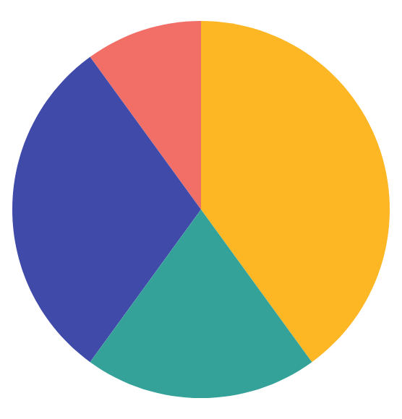
READING COMPREHENSION WORKSHEETS
Title
30%
Venus has a beautiful name but is hot
Story
20%
Jupiter is a gas giant and the biggest planet
Underline
40%
Earth is the third planet from the Sun
Definitions
10%
Mercury is the closest planet to the Sun
Follow the link in the graph to modify its data and then paste the new one here. For more info, click here

Slide 31
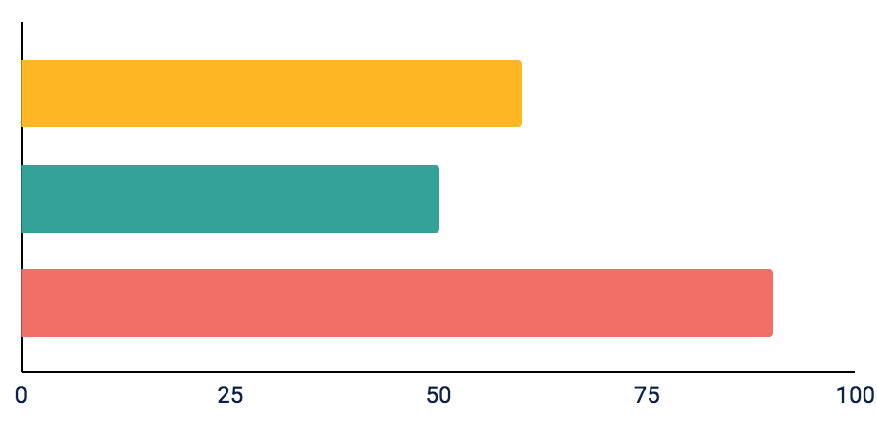
READING COMPREHENSION WORKSHEETS
Reading
Despite being red, Mars is a cold place
60%
50%
90%
Follow the link in the graph to modify its data and then paste the new one here. For more info, click here

Slide 32
READING COMPREHENSION WORKSHEETS
01
02
03
Main idea
Inference
Sequence
Mars is actually a very cold place
Mercury is the smallest planet
Jupiter is the biggest planet

Slide 33
Instructions for use
If you have a free account, in order to use this template, you must credit Slidesgo in your final presentation. Please refer to the next slide to read the instructions for premium users.
As a Free user, you are allowed to:
- Modify this template.
- Use it for both personal and commercial projects.
You are not allowed to:
- Sublicense, sell or rent any of Slidesgo Content (or a modified version of Slidesgo Content).
- Distribute Slidesgo Content unless it has been expressly authorized by Slidesgo.
- Include Slidesgo Content in an online or offline database or file.
- Offer Slidesgo templates (or modified versions of Slidesgo templates) for download.
- Acquire the copyright of Slidesgo Content.
For more information about editing slides, please read our FAQs or visit our blog:
https://slidesgo.com/faqs and https://slidesgo.com/slidesgo-school

Slide 34
Instructions for use (premium users)
As a Premium user, you can use this template without attributing Slidesgo.
You are allowed to:
Modify this template.
Use it for both personal and commercial purposes.
Hide or delete the “Thanks” slide and the mention to Slidesgo in the credits.
Share this template in an editable format with people who are not part of your team.
You are not allowed to:
Sublicense, sell or rent this Slidesgo Template (or a modified version of this Slidesgo Template).
Distribute this Slidesgo Template (or a modified version of this Slidesgo Template) or include it in a database or in any other product or service that offers downloadable images, icons or presentations that may be subject to distribution or resale.
Use any of the elements that are part of this Slidesgo Template in an isolated and separated way from this Template.
Register any of the elements that are part of this template as a trademark or logo, or register it as a work in an intellectual property registry or similar.
For more information about editing slides, please read our FAQs or visit our blog:
https://slidesgo.com/faqs and https://slidesgo.com/slidesgo-school

Slide 35
Infographics
You can add and edit some infographics to your presentation to present your data in a visual way.
Choose your favourite infographic and insert it in your presentation using Ctrl C + Ctrl V or Cmd C + Cmd V in Mac.
Select one of the parts and ungroup it by right-clicking and choosing “Ungroup”.
Change the color by clicking on the paint bucket.
Then resize the element by clicking and dragging one of the square-shaped points of its bounding box (the cursor should look like a double-headed arrow). Remember to hold Shift while dragging to keep the proportions.
Group the elements again by selecting them, right-clicking and choosing “Group”.
Repeat the steps above with the other parts and when you’re done editing, copy the end result and paste it into your presentation.
Remember to choose the “Keep source formatting” option so that it keeps the design. For more info, please visit our blog.

