Slide 1
Understanding Post- method Pedagogy

Slide 2
The Concept of Method
Theory and Practice of Methods is an integral part of language teacher education programs all over the world
survey of 120 teacher education programs for TESOL:
Methods course functions as the primary vehicle for the development of basic knowledge and skill in the prospective teacher
specific classroom techniques receive “the greatest amount of attention and time in the methods courses”
The three main books deal almost exclusively with specific language teaching methods

Slide 3
The term methods does not refer to what teachers actually do in the classroom; rather, it refers to established methods conceptualized and constructed by experts in the field.
The most common methods included in books are :
Audiolingual Method
Communicative Methods
Community Language Learning,
Direct Method
Grammar-Translation Method
Natural Approach
Oral Approach
Silent Way
Situational Language Teaching
Suggestopedia
Total Physical Response

Slide 4
Note that:
These methods are not different paths
There is considerable overlap
A new method is usually a variant of an existing method
To be able to analyse we prefer classify them as:
(a) language-centered methods
(b) learner-centered methods
(c) learning-centered methods

Slide 5
Language-Centered Methods
principally concerned with linguistic forms, also called grammatical structures
Opportunities for learners to practice preselected, pre-sequenced linguistic structures
form-focused exercises
language development is largely intentional rather than incidental
Language development takes place through conscious effort
language learning as a linear, additive process “accumulated entities”
Assumption: preoccupation with form will ultimately lead to a mastery of the target language and that learners can draw from this formal repertoire whenever they wish to communicate in the target language outside the class

Slide 6
In practice:
Vocabulary items are carefully selected for their potential use
graded from simple to complex
teacher’s task is to introduce them one at a time
There is explicit introduction, analysis, and explanation of linguistic systems

Slide 7
Learner-Centered Methods
Concerned with language use and learner needs
opportunities for learners to practice preselected, presequenced grammatical structures as well as communicative functions
meaning-focused activities are used
language development is largely intentional rather than incidental
making language learners grammatically accurate and communicatively fluent
Assumption: preoccupation with both form and function will ultimately lead to target language mastery and that the learners can make use of both formal and functional repertoire to fulfil their communicative needs outside the class

Slide 8
take into account the learner’s real-life language use for social interaction or for academic study
present necessary linguistic structures in communicative contexts
accumulated entities
represent structures plus notions and functions
Each functional category could be matched with one or more linguistic Forms
sequentially presented and systematically explained

Slide 9
Learning-Centered Methods
principally concerned with learning
opportunities for learners to participate in open-ended meaningful interaction
communicative activities or problem-solving tasks
Assumption: preoccupation with meaning-making will ultimately lead to grammatical as well as communicative mastery of the language and that learners can learn through the process of communication

Slide 10
language development is considered more incidental than intentional
language development is a nonlinear process
does not require preselected, pre-sequenced systematic language input
requires conditions in which learners can engage in meaningful activities
Language is learned when the learner’s attention is focused on understanding, saying and doing something with language
linguistic systems are too complex to be neatly analysed, explicitly explained, and sequentially presented
Rely on insights from research in second language acquisition which can inform the theory and practice

Slide 11
Theoretical principles
insights derived from linguistics, second language acquisition, cognitive psychology, information sciences, and other allied disciplines that provide theoretical bases for the study of language, language learning, and language teaching

Slide 12
Classroom procedures
teaching and learning techniques indicated by the syllabus designer and/or the materials producer, and adopted/adapted by the teacher and the learner in order to jointly accomplish the goals of language learning and teaching in the classroom

Slide 13
Limitations of the Concept of Method
First and foremost, methods are based on idealized concepts geared toward idealized contexts
needs, wants, and situations are unpredictably numerous
no idealized method can visualize all the variables
the conception and construction of methods have been largely guided by a one-size-fits-all, cookie-cutter approach
methods tend to wildly drift from one theoretical extreme to the other
certain aspects of learning and teaching get overly emphasized while certain others are utterly ignored
too inadequate and too limited to satisfactorily explain the complexity of language teaching operations
multiple factors such as teacher cognition, learner perception, societal needs, cultural contexts, political exigencies, economic imperatives, and institutional constraints

Slide 14
Conclusion
“the term method is a label without substance” (Clarke, 1983, p. 109)
“diminished rather than enhanced our understanding of language teaching” (Pennycook, 1989, p. 597)
“language teaching might be better understood and better executed if the concept of method were not to exist at all” (Jarvis,1991, p. 295).

Slide 15
Dissatisfaction with Method
Studies show clearly:
• teachers who are trained in and even swear by a particular method do not conform to its theoretical principles and classroom procedures
• teachers who claim to follow the same method often use different classroom procedures that are not consistent with the adopted method
• teachers who claim to follow different methods often use same classroom procedures
• over time, teachers develop and follow a carefully delineated task hierarchy, a weighted sequence of activities not necessarily associated with any established method.

Slide 16
“no single perspective on language, no single explanation for learning, and no unitary view of the contributions of language learners will account for what they must grapple with on a daily basis” (Larsen-Freeman, 1990, p. 269).
That is why…
teachers rely on their intuitive ability and experiential knowledge
And have chosen to be ‘eclectic’.

Slide 17
What is wrong with ‘eclecticism’?
“The weakness of the eclectic position is that it offers no criteria according to which we can determine which is the best theory, nor does it provide any principles by which to include or exclude features which form part of existing theories or practices. The choice is left to the individual’s intuitive judgment and is, therefore, too broad and too vague to be satisfactory as a theory in its own right.”
comfort of a context-sensitive professional theory
confidence of a fully developed personal theory

Slide 18
Postmethod Condition
It includes three interrelated attributes:
First search for an alternative to method rather than an alternative method
we need to refigure the relationship between the theorizer and the practitioner of language teaching.
It empowers practitioners to construct personal theories of practice
Looks for enabling practitioners to generate location-specific, classroom-oriented innovative strategies.

Slide 19
Second: the post-method condition signifies teacher autonomy.
It recognizes the teachers’ potential (how to teach + how to act autonomously within the academic and administrative constraints imposed)
It promotes the ability of teachers to know how to develop a critical approach in order to selfobserve, self-analyze, and self-evaluate their own teaching practice for effective desired changes

Slide 20
Third: based on pragmatism unlike eclecticism constrained by the conventional
It is based on the pragmatics of pedagogy where “the relationship between theory and practice, ideas and their actualization, can only be realized within the domain of application, that is, through the immediate activity of teaching” (Widdowson, 1990, p. 30).
It focuses on how classroom learning can be shaped and reshaped by teachers as a result of selfobservation, self-analysis, and self-evaluation.

Slide 21
To do so…..
Teachers need “a sense of plausibility.” (Prabhu, 1990)
subjective understanding
peer consultation
own experience
professional education

Slide 22
What is the goal?
“not whether it implies a good or bad method, but more basically, whether it is active, alive, or operational enough to create a sense of involvement for both the teacher and the student”

Slide 23
Postmethod Pedagogy
Is a three-dimensional system
The Parameter of Particularity
The Parameter of Practicality
The Parameter of Possibility

Slide 24
The Parameter of Particularity
one works for and through particularity at the same time
particular
sociocultural milieu
particular group of teachers
particular group of learners
particular institutional context
particular set
of goals

Slide 25
How?
It starts with practicing teachers, either individually or collectively, observing their teaching acts, evaluating their outcomes, identifying problems, finding solutions, and trying them out to see once again what works and what doesn’t.
Such a continual cycle of observation, reflection, and action is a prerequisite for the development of context-sensitive pedagogic theory and practice.

Slide 26
The Parameter of Practicality
a teacher-generated theory of practice
no theory of practice can be fully useful unless there is practice

Slide 27
The Parameter of Possibility
any pedagogy is implicated
in relations of power and dominance
recognition of learners’ and teachers’ subject-positions
Individual identity

Slide 28
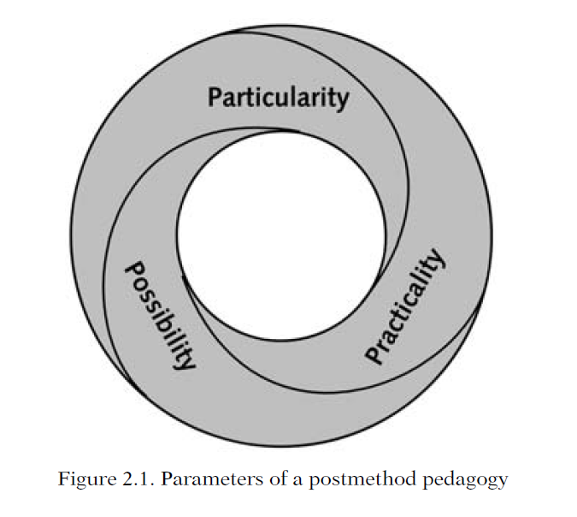
Inevitably, the boundaries of the particular, the practical, and the possible are blurred. The result of such a relationship will vary from context to context depending on what the participants bring to bear on it.

Slide 29
Macrostrategic Framework
Macrostrategies
Microstrategies

Slide 30
Macrostrategies
Defined as:
guiding principles derived from historical, theoretical, empirical, and experiential insights related to L2 learning and teaching.
theory-neutral & method-neutral
a general plan/broad guideline
are made operational in the classroom through microstrategies

Slide 31
• Maximize learning opportunities:
This macrostrategy envisages teaching as a process of creating and utilizing learning opportunities, a process in which teachers strike a balance between their role as managers of teaching acts and their role as mediators of learning acts
• Minimize perceptual mismatches:
This macrostrategy emphasizes the recognition of potential perceptual mismatches between intentions and interpretations of the learner, the teacher, and the teacher educator
• Facilitate negotiated interaction:
This macrostrategy refers to meaningful learner-learner, learner-teacher classroom interaction in which learners are entitled and encouraged to initiate topic and talk, not just react and respond;

Slide 32
Promote learner autonomy:
This macrostrategy involves helping learners learn how to learn, equipping them with the means necessary to self-direct and self-monitor their own learning
• Foster language awareness:
This macrostrategy refers to any attempt to draw learners’ attention to the formal and functional properties of their L2 in order to increase the degree of explicitness required to promote L2 learning;
• Activate intuitive heuristics(using experience):
This macrostrategy highlights the importance of providing rich textual data so that learners can infer and internalize underlying rules governing grammatical usage and communicative use;

Slide 33
Contextualize linguistic input:
This macrostrategy highlights how language usage and use are shaped by linguistic, extralinguistic, situational, and extrasituational contexts
• Integrate language skills:
This macrostrategy refers to the need to holistically integrate language skills traditionally separated and sequenced as listening, speaking, reading, and writing
• Ensure social relevance:
This macrostrategy refers to the need for teachers to be sensitive to the societal, political, economic, and educational environment in which L2 learning and teaching take place
Raise cultural consciousness:
This macrostrategy emphasizes the need to treat learners as cultural informants so that they are encouraged to engage in a process of classroom participation that puts a premium on their power/knowledge.

Slide 34
The Pedagogic Wheel
in a systemic relationship
supporting one another.

Slide 35
